Slide 1
TREE DATA STRUCTURE

Slide 2
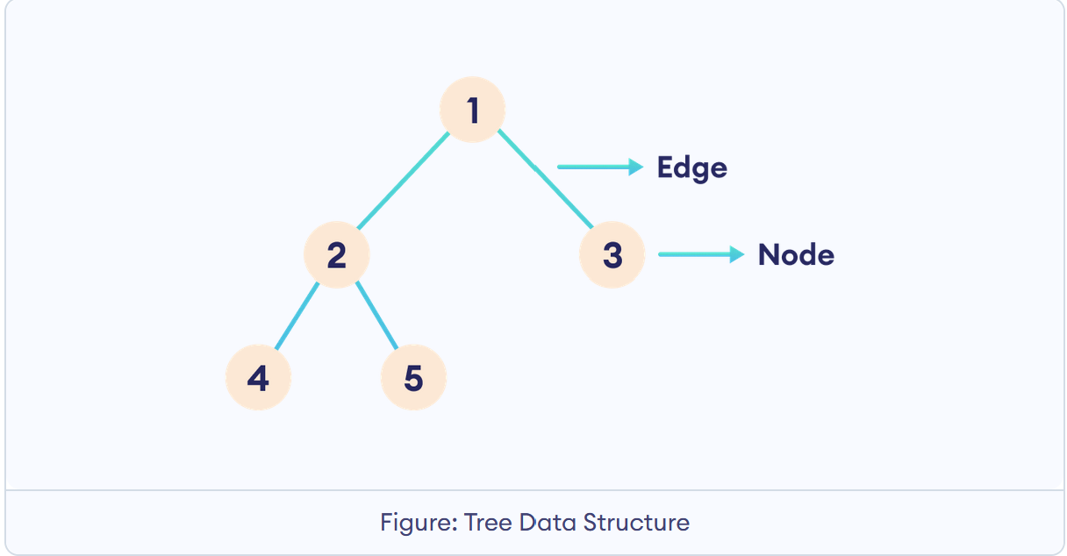
Introduction to Trees
A tree is a hierarchical data structure consisting of nodes connected by edges.
Consider the tree below:
Here,
The circles are nodes.
The lines are edges.
In a tree, nodes are the individual
elements, and edges connect these
nodes.

Slide 3
Why Tree Data Structure?
Other data structures such as arrays, linked list, stack, and queue are linear data structures that store data sequentially. In order to perform any operation in a linear data structure, the time complexity increases with the increase in the data size. But, it is not acceptable in today's computational world.
Different tree data structures allow quicker and easier access to the data as it is a non-linear data structure.

Slide 4
Tree Terminologies
Node: A node is an entity that contains a key or value and pointers to its child nodes.
Edge: It is the link between any two nodes.
Root: It is the topmost node of a tree.
Leaf: A node with no child nodes, often referred to as a terminal node.
Parent: The connected node directly above the current node.
Child: The connected nodes directly below a particular node.
Siblings: The nodes in a tree that share the same parent node.

Slide 5
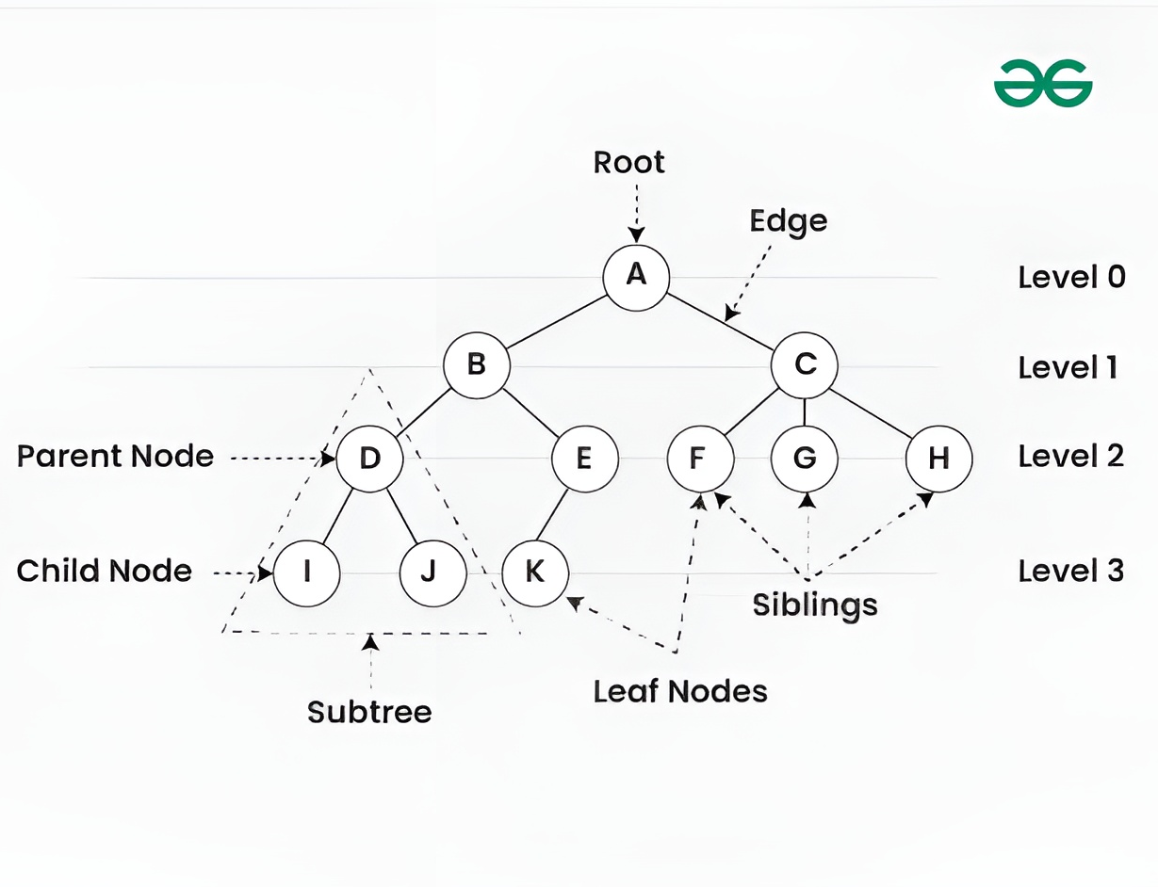
Tree Terminologies Cont…

Slide 7
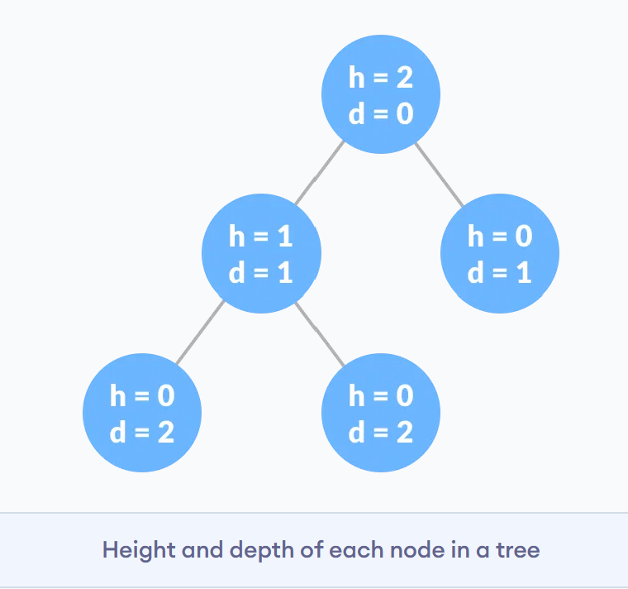
Tree Terminologies Cont…
Height of a Node:
The height of a node is the number of edges from the node to the deepest leaf (ie. the longest path from the node to a leaf node).
Depth of a Node
The depth of a node is the number of edges from the root to the node.
Height of a Tree
The height of a Tree is the height of the root node or the depth of the deepest node.

Slide 8
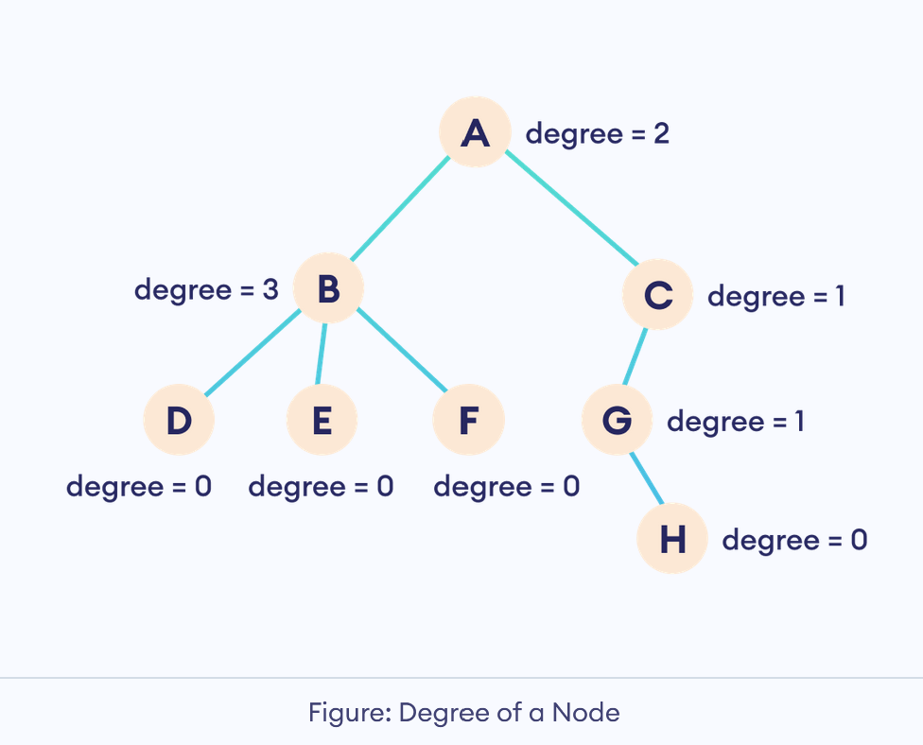
Tree Terminologies Cont…
Degree of a Node
The degree of a node is the total number of branches of that node.
Degree of a Tree
The degree of a tree is the maximum degree of any node in the tree.

Slide 9
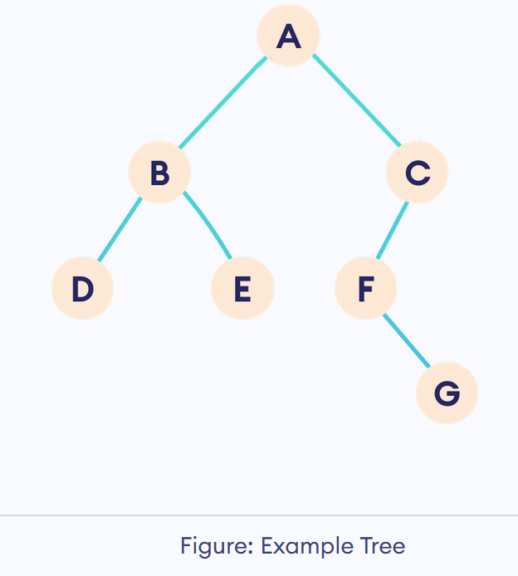
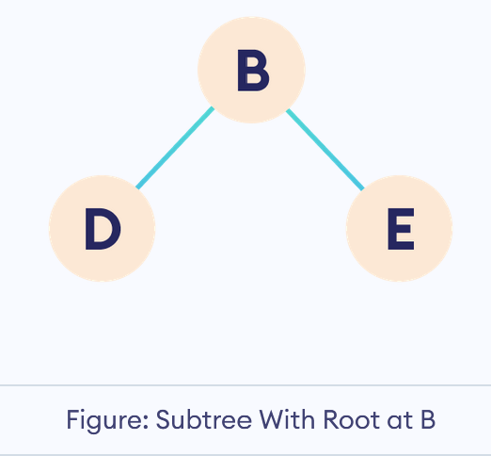
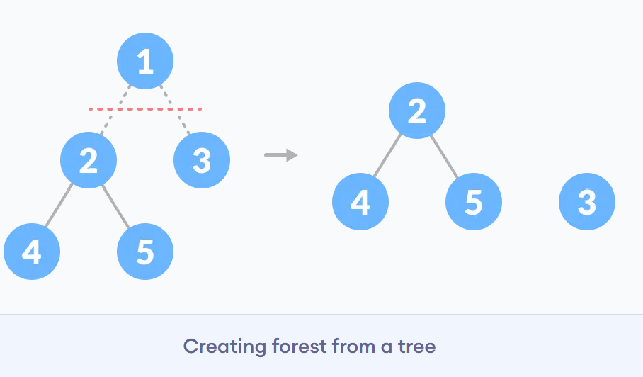
Tree Terminologies Cont…
Subtrees
A subtree is a portion of a tree that is derived from a specific node.
Forest
In data structures, a forest is a set of non-interacting trees.

Slide 10
Tree Applications
Binary Search Trees(BSTs) are used to quickly check whether an element is present in a set or not.
Heap is a kind of tree that is used for heap sort.
A modified version of a tree called Tries is used in modern routers to store routing information.
Most popular databases use B-Trees and T-Trees, which are variants of the tree structure we learned above to store their data
Compilers use a syntax tree to validate the syntax of every program you write.

Slide 11
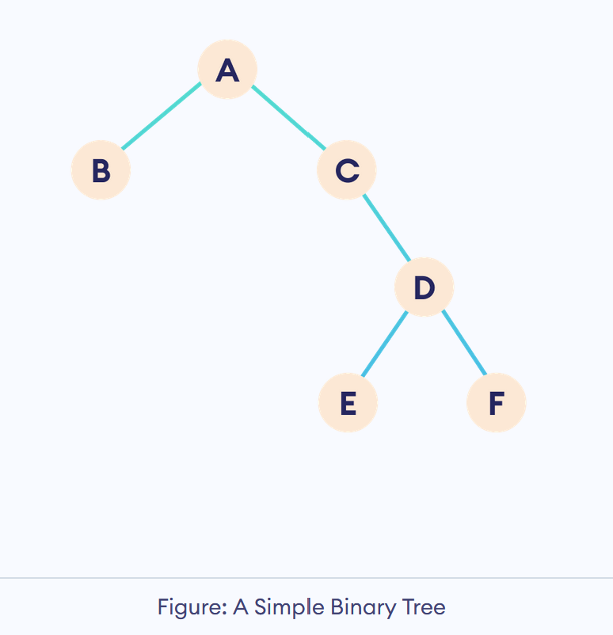
Binary Tree
A binary tree is a tree that has, at most, two children.
Each node of a binary tree consists of three items:
data item
address of left child
address of right child

Slide 12
Types of Binary Tree
Binary trees are classified into different types. In the following lessons, we will be discussing the following types of binary trees:
Full Binary Tree
Perfect Binary Tree
Complete Binary Tree
Degenerate Tree

Slide 13
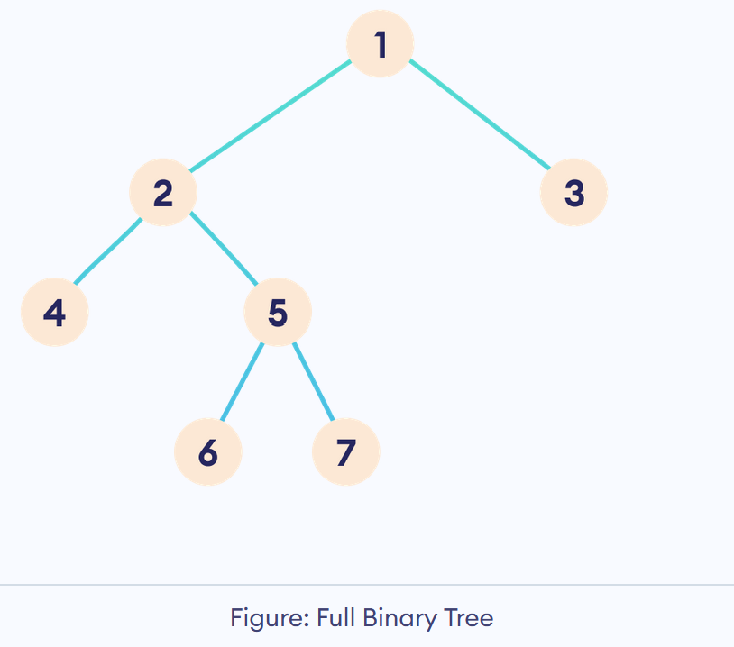
Types of Binary Tree
Full Binary Tree
A full Binary tree is a special type of binary tree in which every parent node/internal node has either two or no children.

Slide 14
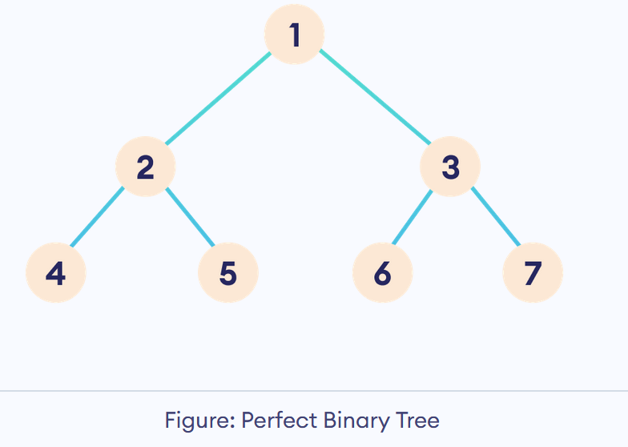
Types of Binary Tree
Perfect Binary Tree
To be a perfect binary tree, every internal node has exactly two child nodes and all the leaf nodes are at the same level.

Slide 15
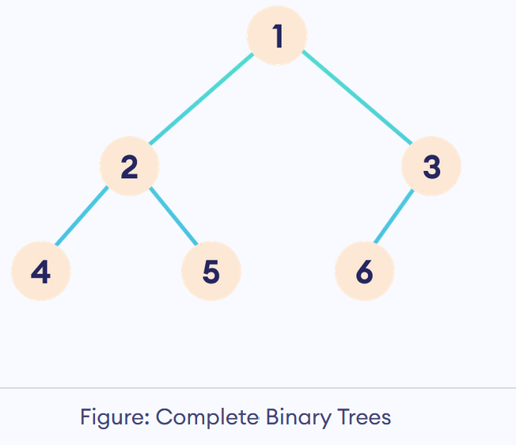
Types of Binary Tree
Complete Binary Tree
A complete binary tree is a binary tree in which all the levels, except possibly the last, are completely filled, and all nodes are as far left as possible.

Slide 16
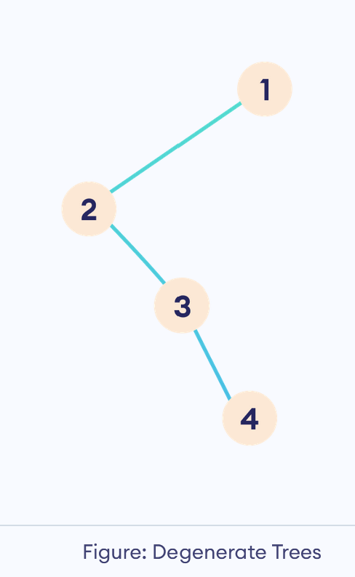
Types of Binary Tree
Degenerate Tree
In degenerate trees, the parent nodes have at most one child node.

Slide 17
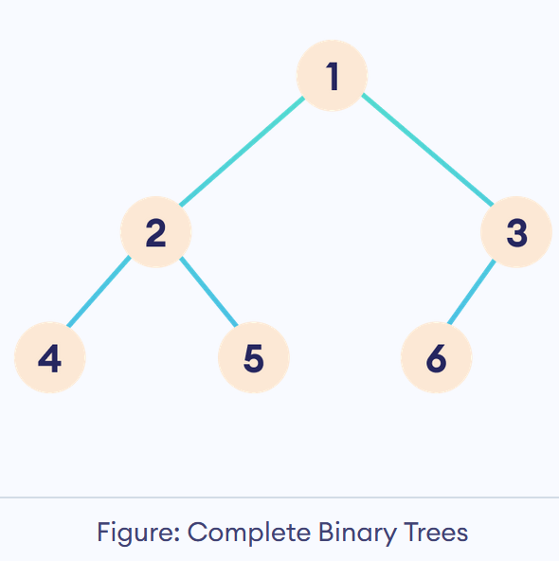
Types of Binary Tree
Complete Binary Tree
A complete binary tree is a binary tree in which all the levels, except possibly the last, are completely filled, and all nodes are as far left as possible.
A complete binary tree is just like a full binary tree, but with two major differences
All the leaf elements must lean towards the left.
The last leaf element might not have a right sibling i.e. a complete binary tree doesn't have to be a full binary tree.

Slide 18
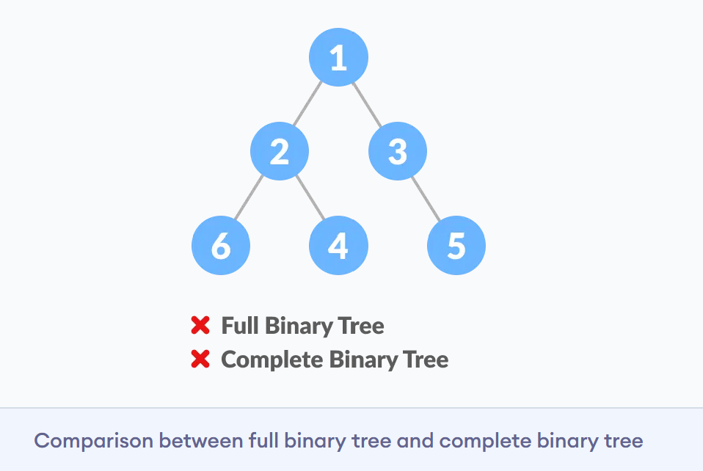
Full Binary Tree vs Complete Binary Tree

Slide 19
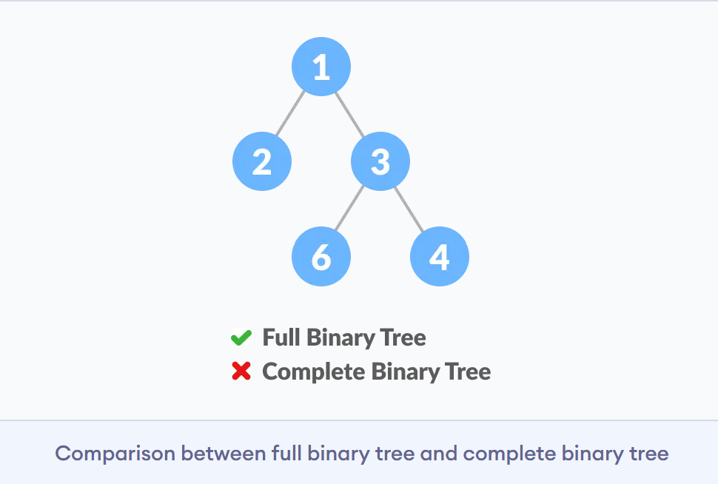
Full Binary Tree vs Complete Binary Tree

Slide 20
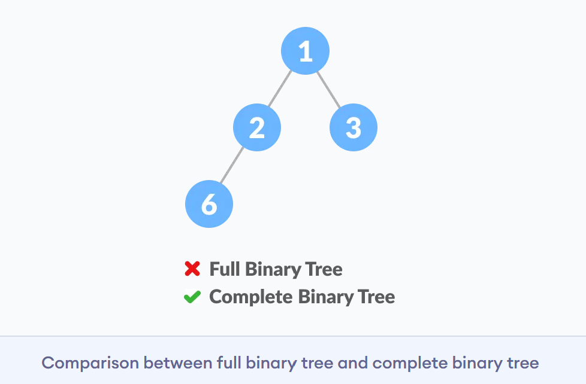
Full Binary Tree vs Complete Binary Tree

Slide 21
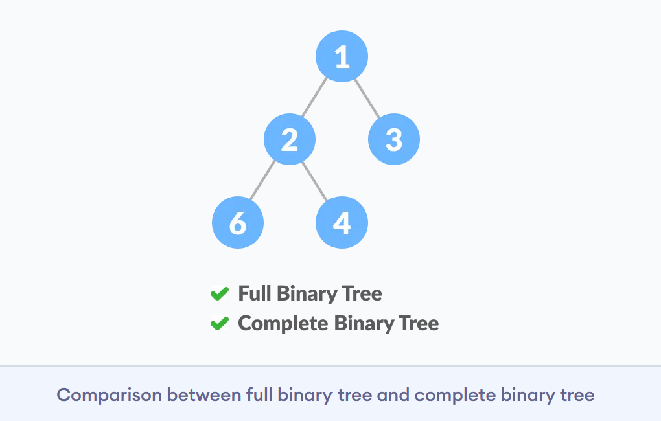
Full Binary Tree vs Complete Binary Tree

Slide 22
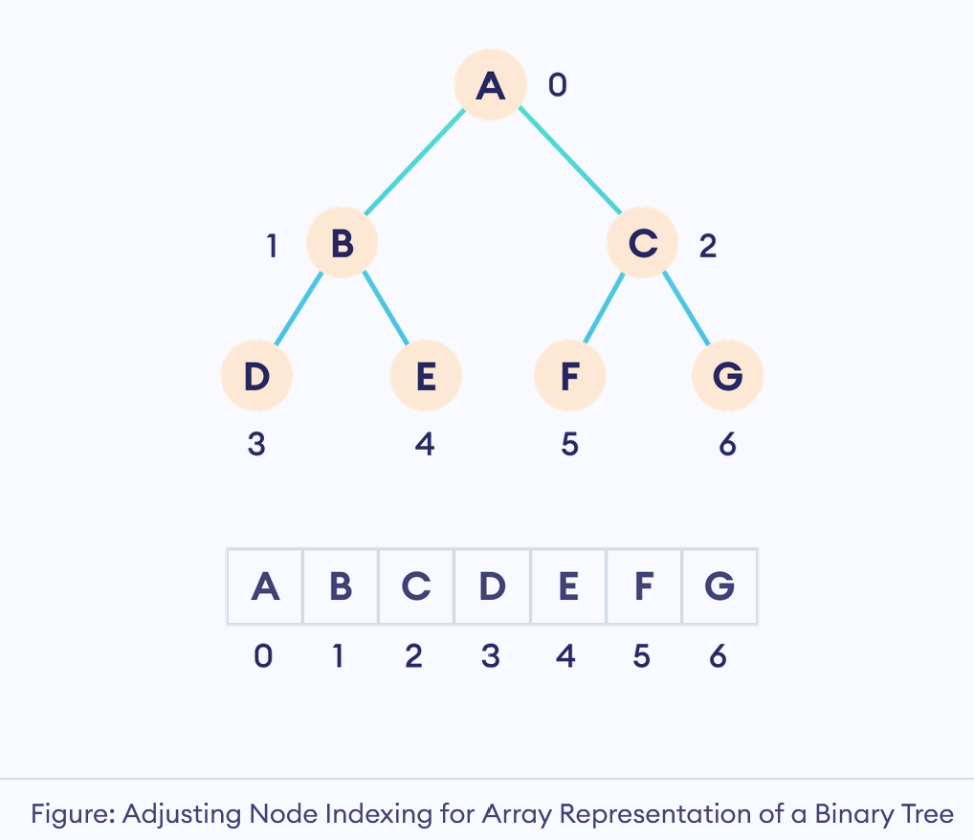
How a Complete Binary Tree is Created?

Slide 23
Heap Sort

Slide 24
Heap Sort
Heap Sort is a popular and efficient sorting algorithm in computer programming. Learning how to write the heap sort algorithm requires knowledge of two types of data structures - arrays and trees.
The initial set of numbers that we want to sort is stored in an array e.g. [10, 3, 76, 34, 23, 32] and after sorting, we get a sorted array [3,10,23,32,34,76].
Heap sort works by visualizing the elements of the array as a special kind of complete binary tree called a heap.

Slide 25
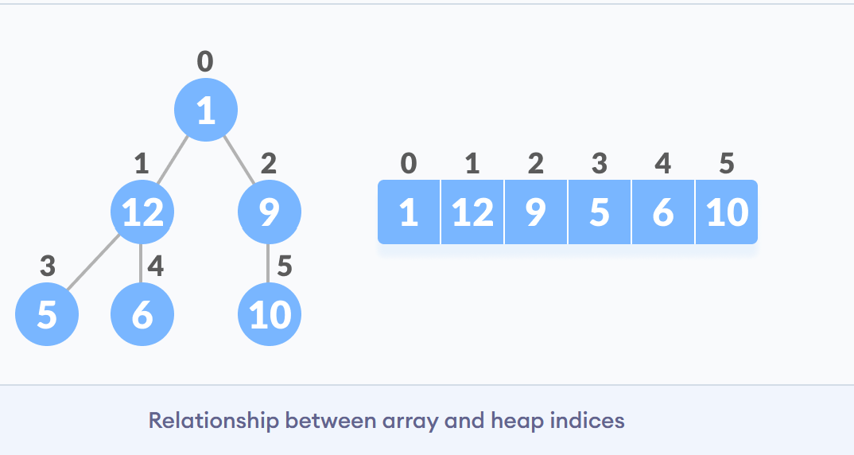
Relationship between Array Indexes and Tree Elements

Slide 26
What is Heap Data Structure?
A binary heap is a complete binary tree with heap property. Hence, a binary heap has the following properties:
It is a complete binary tree.
It satisfies the heap property (either max-heap or min-heap).
All nodes in the tree follow the property that they are greater than their children i.e. the largest element is at the root and both its children and smaller than the root and so on. Such a heap is called a max-heap. If instead, all nodes are smaller than their children, it is called a min-heap

Slide 27
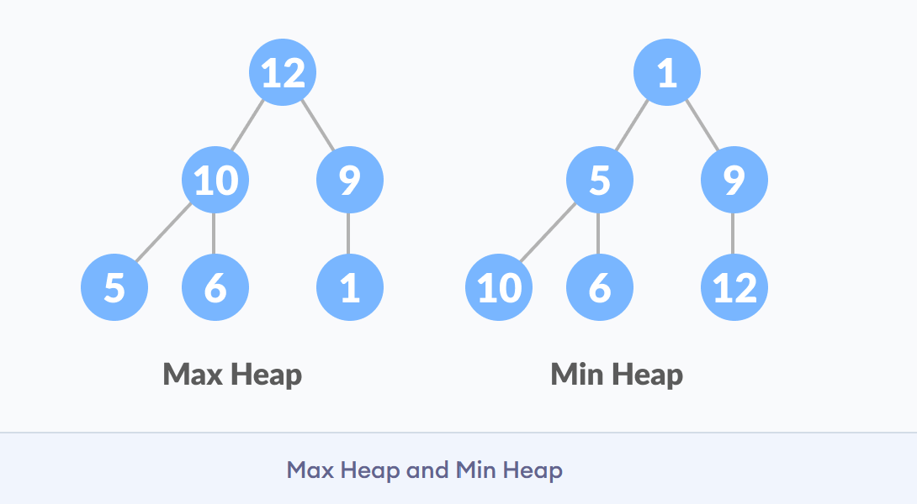
What is Heap Data Structure Cont…

Slide 28
Heapify
Heapify is the process of rearranging nodes in a binary tree such that every node satisfies the heap property.
There are two types of heapify operations:
Heapify Up: Heapfiy up moves up the tree (from leaf to root) while comparing to the current parent element and swapping if needed.
It's used to restore the heap property after inserting a new element to the heap.
Heapify Down: Heapify down moves down the tree, comparing the root to its children and swapping if needed.
It's used to restore the heap property after we have removed the root node from the heap.

Slide 29
Heap Sort Algorithm
First convert the array into a max heap using heapify, Please note that this happens in-place. The array elements are re-arranged to follow heap properties. Then one by one delete the root node of the Max-heap and replace it with the last node and heapify. Repeat this process while size of heap is greater than 1.
Rearrange array elements so that they form a Max Heap.
Repeat the following steps until the heap contains only one element:
Swap the root element of the heap (which is the largest element in current heap) with the last element of the heap.
Remove the last element of the heap (which is now in the correct position). We mainly reduce heap size and do not remove element from the actual array.
Heapify the remaining elements of the heap.
Finally we get sorted array.

Slide 30
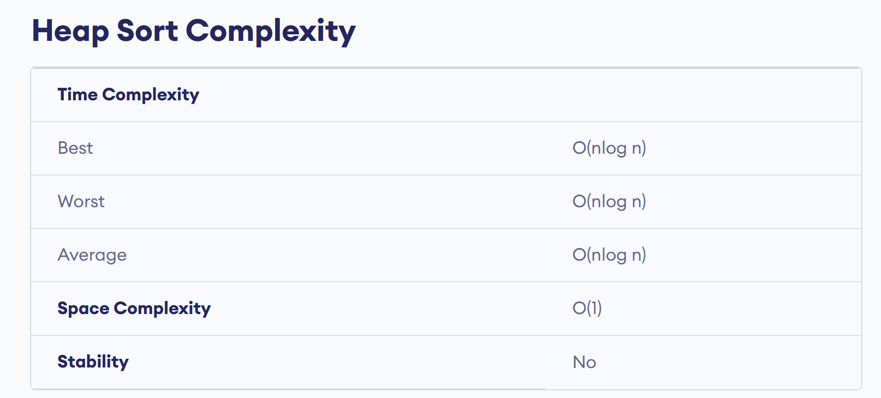

Slide 31
References
https://www.geeksforgeeks.org/heap-sort/
https://www.programiz.com/dsa/heap-sort
https://www.youtube.com/watch?v=HqPJF2L5h9U&t=926s

